Slide 1
Rectangle intersection
Given a number of rectangles, determine which of them intersect.
Student: Dragos Geornoiu
Coordinator: Cristian Mihaescu
Date: April 2014
DCTI – IT Companies Seminary

Slide 2
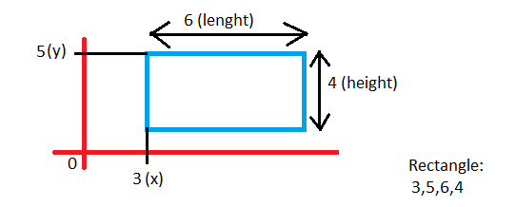
INPUT
An input file which defines on each line a rectangle
X - top left corner’s position on x axis
Y – top left corner’s position on y axis
Length
Height

Slide 3
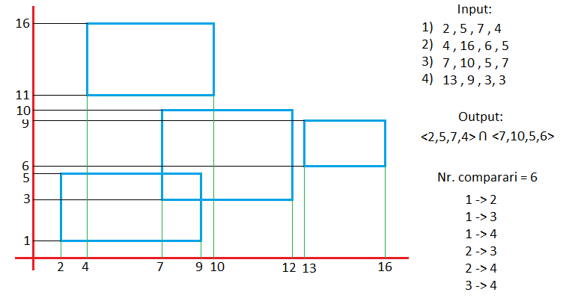
Brute Force

Slide 4
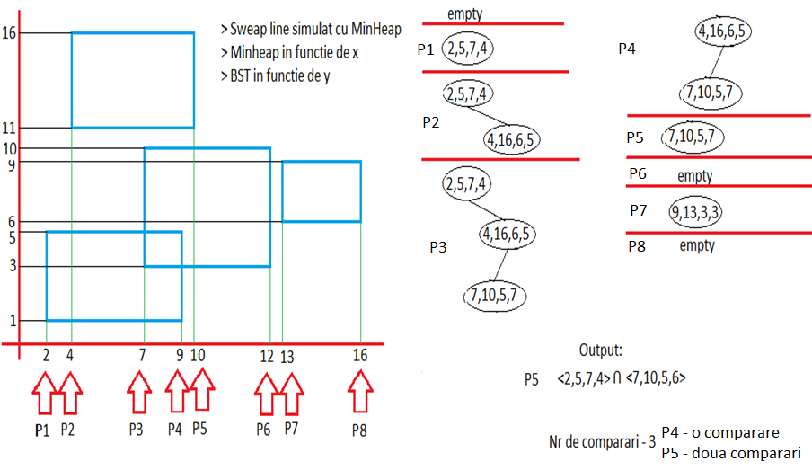
Sweep Line + BST

Slide 5
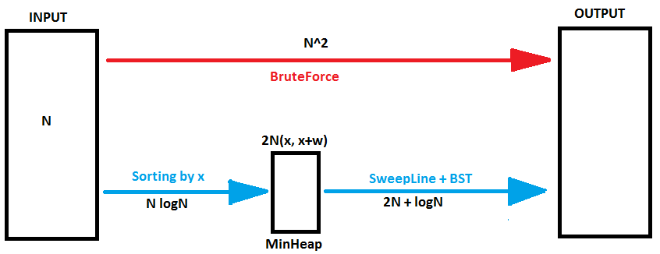

Slide 6
Order of growth | Algorithm Example | Input size solvable in minutes
2N+logN | Sweep Line + BST | Billions
N logN | Sorting | Hundreds of millions
N^2 | Brute Force (2 for loops) | Tens of thausands

Slide 7
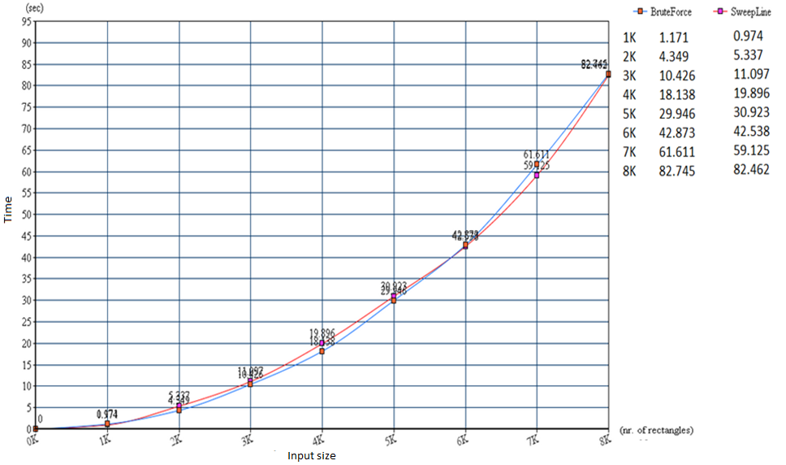
Standard Plot

Slide 8
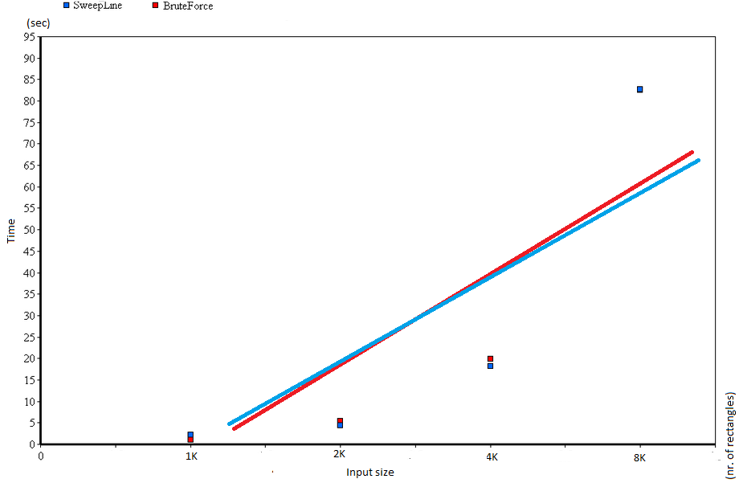
Log-Log Plot

Slide 9
Questions
For code, visit: https://github.com/mihaescu/ADS/tree/master/BST/Geometric%20Applications/Rectangle%20Intersection%20by%20Geornoiu%20Dragos

